Slide 1
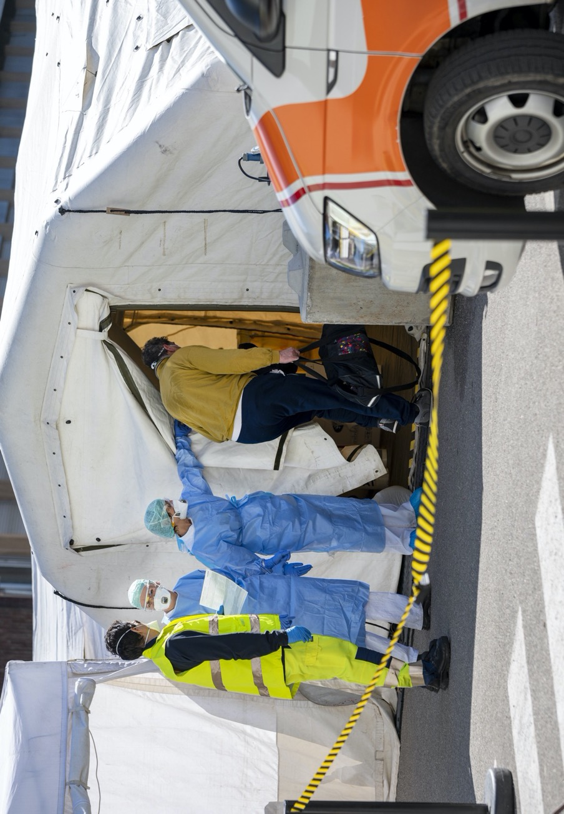
WELCOME
Field Hospital

Slide 2
WELCOME
Admissions
If there is famine in the land, if there is plague, blight, mildew, locust, or caterpillar; if their enemy besieges them in any of their cities; whatever plague, whatever sickness there is; whatever prayer, whatever plea there is from any individual or from all your people Israel, all knowing the afflictions of their own hearts so that they stretch out their hands toward this house; then hear in heaven your dwelling place, forgive, act, and render to all whose hearts you know. I Kings 8:37-40
‘I was a stranger and you did not welcome me, naked and you did not give me clothing, sick and in prison and you did not visit me.’ Then they also will answer, ‘Lord, when was it that we saw you hungry or thirsty or a stranger or naked or sick or in prison, and did not take care of you?’ Then he will answer, ‘Truly I tell you, just as you did not do it to one of the least of these, you did not do it to me.’ MT 25:43-45
1. Touch
I touch the Heart of Welcome.
I hold or imagine a cup or mug of tea, coffee, warm milk … that I would normally offer to guests to make them feel at home. I hold it remembering all the times and ways I have warmly welcomed both friends and strangers.
I remember a small story of being really welcomed when I needed it. I hold that memory, feeling touched by the Spirit of Welcome ... I begin to understand how important something so simple might be in these isolating and alienating times.
I desire to be a Welcoming Person.
I slowly and prayerfully read the prayer texts above. I name all the people I want to welcome, to stretch out my hands to help … I ask the Spirit of Welcome for the gift to be a person of warm welcome and
hospitality, especially if the person before me is sick, afraid, helpless, afflicted, a stranger, or one of the least in community. My heart could be a field hospital for them. I will find a way to do this even if I cannot meet the other face to face.
2. Desire
I breathe in the Spirit of Welcome.
Then I imagine and feel the Spirit of God welcoming me, breathing a special welcome into me.
I breathe it in deeply, wait, then breathe it out through me to warm all those with an anxious heart, and to support those who need urgent healing now.
I repeat as desired – breathing, welcoming, helping quickly …
I end in thanks, considering two questions. Firstly, if possible, how might I make contact and reconnect with the one who really welcomed me? Secondly, to whom and how do I pass on this exercise – who urgently could be a person of welcome now?
3. Welcome
PRAYER TIME:
Go gently, using the generous time you have put aside for this prayer. The three dots … indicate the places to pause.
If you are specially moved at any of the steps, remain there for the rest of the prayer.
FSE FIELD HOSPITAL © Michael Hansen SJ
Contact: field-hospital@fsecloud.life • www.fsecloud.life • JISA ministries www.jisa.org.au

Slide 3

SPIRITUAL STRENGTH
Field Hospital

Slide 4
SPIRITUAL STRENGTH
Emergency
I love you, O Lord, my strength. The Lord is my rock, my fortress, and my deliverer, my God, my rock in whom I take refuge, my shield, and the horn of my salvation, my stronghold.
The cords of death encompassed me; the torrents of hell assailed me; the cords of the house of the dead entangled me; the snares of death confronted me. In my distress I called upon the Lord; to my God I cried for help. From his temple he heard my voice, and my cry to him reached his ears. He reached down from on high, he took me; he drew me out of mighty waters. He brought me out into a broad place; he delivered me, because he delighted in me. Pss 18:1-2,6,16-17,19
1. Touch
I touch the Heart of Spiritual Strength.
I hold or imagine an object that symbolises for me spiritual strength.
I remember a small story of receiving spiritual strength when I needed it. I hold that memory, feeling touched by God’s Spirit of Strength … I begin to understand how important this is needed in these wearying times.
2. Desire
I desire the gift of Strength.
I consider three things, taking a few minutes to explore each. I ask myself: Where is the spiritual strength present in my life? …
Where is the spiritual strength absent in my life? …
What is the contrary or opposite of this strength for me? …
I ask the Spirit of God to strengthen me, and all the ill, the dying, the weak, all who feel hopeless and in need of urgent care.
3. Choice
Today I choose the Way of Strength.
I slowly and prayerfully read the prayer text above. I choose, in three thoughtful steps, the direction I wish to take:
I choose the strengthening way, led by the good spirit, toward greater love ...
I reject the disheartening way, the voices of discouragement, led by the bad spirit … I turn and walk in the contrary direction, from demoralized, to strong, to peaceful …
4. Strong
I rest in the Spirit of Strength.
I imagine God addresses me by name, saying, ‘Welcome to the stronghold of my heart. Be steadfast.’
So I rest now, and reflectively through the whole day, in the Spirit’s gentle strength, protection and delight. I feel stronger ...
I conclude in thanks, considering two questions. Firstly, if possible, how might I make contact and reconnect with the one who made me stronger? Secondly, who urgently needs spiritual strengthening now? How can I help them find it?
PRAYER TIME:
Go gently, using the generous time you have put aside for this prayer. The three dots … indicate the places to pause.
If you are specially moved at any of the steps, remain there for the rest of the prayer.
FSE FIELD HOSPITAL © Michael Hansen SJ
Contact: field-hospital@fsecloud.life • www.fsecloud.life • JISA ministries www.jisa.org.au

Slide 5

PROVIDING A LIFE LINE
Field Hospital

Slide 6
PROVIDING A LIFE LINE
Triage
Save me, O God, for the waters have come up to my neck. I sink in deep mire, where there is no foothold; I have come into deep waters, and the flood sweeps over me. I am weary with my crying; my throat is parched. My eyes grow dim with waiting for my God. I have become a stranger to my kindred, an alien to my mother’s children.
But as for me, my prayer is to you, O Lord. O God, in the abundance of your steadfast love, answer me. With your faithful help rescue me. I am lowly and in pain; let your salvation, O God, protect me. Pss 69
1. Touch
I touch the Heart of a Lifeline.
I take up or imagine a short piece of string, yarn, or cord, considering it a symbol of a lifeline. I hold one end, that is me, and the other end, that is the Spirit who keeps me safe. I ponder the safety, sustaining life and unbreakable strength of that connection.
I remember a small story of being rIescued, given a life line, by God or another, when I really needed rescuing. I hold that memory, feeling touched by the Spirit of Life ... I begin to see how present events swept over us all, and how I may need a life- line.
2. Desire
I desire the Gift of Safety and Support.
I slowly and prayerfully read the prayer text above. I name all the things I wish to be rescued from …
I ask the Spirit for safety, for safe-keeping, for a lifeline of help, that will never let me go – especially in these most precarious times.
3. Safe
I breathe in the Spirit of Rescue.
Then I imagine and feel the Spirit of Rescue breathing the gift of rescue and loving security into me. I breathe it in deeply, wait, then breathe it out into every crevice of fear, mire of anxiety, flood of tears and cry for help within me. I imagine both the Spirit's direct help and indirect help through others who can be a lifeline for me.
I repeat as desired – breathing, safe, secure …
I conclude in thanks, considering two questions. Firstly, if possible, how might I make contact and reconnect with the one who kept me safe? Secondly, to whom and how do I pass on this exercise - who urgently needs safety now?
PRAYER TIME:
Go gently, using the generous time you have put aside for this prayer. The three dots … indicate the places to pause.
If you are specially moved at any of the steps, remain there for the rest of the prayer.
FSE FIELD HOSPITAL © Michael Hansen SJ
Contact: field-hospital@fsecloud.life • www.fsecloud.life • JISA ministries www.jisa.org.au

Slide 7

THE CPR OF PEACE
Field Hospital

Slide 8
THE CPR OF PEACE
First Aid
As God’s chosen ones, holy and beloved, clothe yourselves with compassion, kindness, humility, meekness, and patience. Above all, clothe yourselves with love, which binds everything together in perfect harmony. And let the peace of Christ rule in your hearts.
Col 3:12-16
See, I open my mouth; the tongue in my mouth speaks.
My words declare the uprightness of my heart, and what my lips know they speak sincerely. The spirit of God has made me, and the breath of the Almighty gives me life. Job 33:2-6
I touch the Heart of Peace.
I take a slow breath, in and out – a breath in to receive the Spirit of Peace, and a breath out to breathe out all the anxiety, agitation, fears and burdens I carry within me. This breath of body and Spirit, is life in every sense. I repeat, feeling peace settle in me.
I remember a small story of someone who gave me deep peace when I was afraid and lost in the demands of ever-changing distress. I hold that memory feeling touched by the Spirit of Peace ... I begin to understand how such peace is so desirable in these unsettling times.
1. Touch
2. Desire
I desire the Gift of Peace.
I slowly and prayerfully read the prayer texts above.
I name all the places in my life where I desire the gift of peace …
I ask the Spirit for peace, serenity and harmony in my heart, and for the breath that gives me Life.
3. Peace
I breathe in the Spirit of Peace.
I imagine and feel the Spirit of Peace breathing deep, harmonious peace into me.
I breathe it in deeply, wait, then breathe it out to into my agitations and worries, into my spiritual life, desires and relationships. And I pray this peace spreads far.
I repeat as desired – breathing, peaceful, in harmony …
I conclude in thanks, considering two questions. Firstly, if possible, how might I make contact and reconnect with the one who brought me great peace? Secondly, to whom and how do I pass on this exercise - who urgently needs peace now?
PRAYER TIME:
Go gently, using the generous time you have put aside for this prayer. The three dots … indicate the places to pause.
If you are specially moved at any of the steps, remain there for the rest of the prayer.
FSE FIELD HOSPITAL © Michael Hansen SJ
Contact: field-hospital@fsecloud.life • www.fsecloud.life • JISA ministries www.jisa.org.au

Slide 9

RESTORING INTIMACY
Field Hospital

Slide 10
RESTORING INTIMACY
Critical Care
It was I, the Lord, who taught Ephraim to walk,
I took them up in my arms; but they did not know that I healed them. I led them with cords of human kindness, with bands of love.
I was to them like those who lift infants to their cheeks. I bent down to them and fed them. Hosea 11:3-4
1. Touch
I touch the Heart of Intimacy with the Spirit.
I find or imagine an object that symbolises divine intimacy for me. I feel the Spirit of Intimacy surround me.
I remember a small story of someone who taught me what intimacy with God is all about. If praying alone I hold that memory, if I am praying in a group, I share it with them, feeling touched by the Spirit of Intimacy … I begin to understand how much a personal intimacy with the Spirit is in these seemingly godless times.
I desire the Gift of Divine Intimacy.
I consider three things, taking a few minutes to explore each. I ask myself: Where is intimacy with the Spirit present in my life? …
Where is intimacy with the Spirit absent in my life? …
What is the contrary or opposite of my intimacy with the Spirit? …
I ask the Spirit for the gift of intimacy, especially when I am drawn to actions that will cut me off from a loving, personal presence.
2. Desire
3. Choice
Today I choose the Way of Intimacy.
I slowly and prayerfully read the prayer text above. I choose, in three thoughtful steps, the direction I wish to take:
I choose to follow the way of Intimacy, relishing the enfolding arms of the Spirit.
I reject the way of alienation, of being separated from the Spirit, tricked by a bad spirit. I turn and walk in the contrary direction, from separation, to intimacy, to deep peace.
4. Intimate
I rest in the Intimate Spirit
I imagine the Intimate Spirit who addresses me by name saying, ‘I would love it if we could each give and receive from one another, our affection, even love in time.'
I rest, for a time, now and reflectively throughout the whole day, in the Intimate Spirit. I am lifted up, healed, fed and loved …
I conclude in thanks, considering two questions. Firstly, if possible, how might I make contact and reconnect with the one who was so intimate with me? Secondly, to whom and how do I pass on this exercise - who urgently needs intimacy with the Spirit now?
:
FSE FIELD HOSPITAL © Michael Hansen SJ
Contact: field-hospital@fsecloud.life • www.fsecloud.life • JISA ministries www.jisa.org.au

Slide 11

ANTIBODIES FOR NEW LIFE
Field Hospital

Slide 12
ANTIBODIES for NEW LIFE
Immunology
A new heart I will give you, and a new spirit I will put within you; and I will remove from your body the heart of stone and give you a heart of flesh. Ezek 36:26-28
The thought of my affliction and my homelessness is wormwood and gall! My soul continually thinks of it and is bowed down within me.
But this I call to mind, and therefore I have hope:
The steadfast love of the Lord never ceases, his mercies never come to an end; they are new every morning. Lam 3:19-24
1. Touch
I touch the Heart of New Life.
A seedling is a seed with first growth. An egg holds the promise of new life, yet to hatch – a mystery to look forward to. It is also an ancient symbol of resurrection. Holding either seed or egg, I consider what has helped me to grow spiritually.
I remember a small story of someone who gave me new life. If praying alone I hold that memory, if I am praying in a group, I share it with them, listening in turn to their stories, feeling touched by the Spirit of New Life ... I begin to understand how important moving forward into new life is in these deadly times.
2. Desire
I desire a New Life and New Spirit.
I slowly and prayerfully read the prayer texts above.
I name all the new things I desire in my life, however audacious …
I ask the Spirit for the gift of a new self, for greater wholeness at the end of this crisis. May the Spirit bring new life from any dead, dark, wounded places in me.
3. New Life
I breathe in a New Spirit.
I imagine and feel the Spirit breathing new life into me with a ceaseless, steadfast love.
I breathe it in deeply, wait, then breathe it out into my present circumstances, to sweep away old things, dead plans, stagnation and despair, so to breathe freely again.
I repeat as desired – breathing, renewing, growing …
I conclude in thanks, considering two things. First, if possible, can I get in touch with the one who gave me new life, to reconnect. Second, Secondly, to whom and how do I pass on this exercise. Urgently, who needs new life now?
FSE FIELD HOSPITAL © Michael Hansen SJ
Contact: field-hospital@fsecloud.life • www.fsecloud.life • JISA ministries www.jisa.org.au

Slide 13
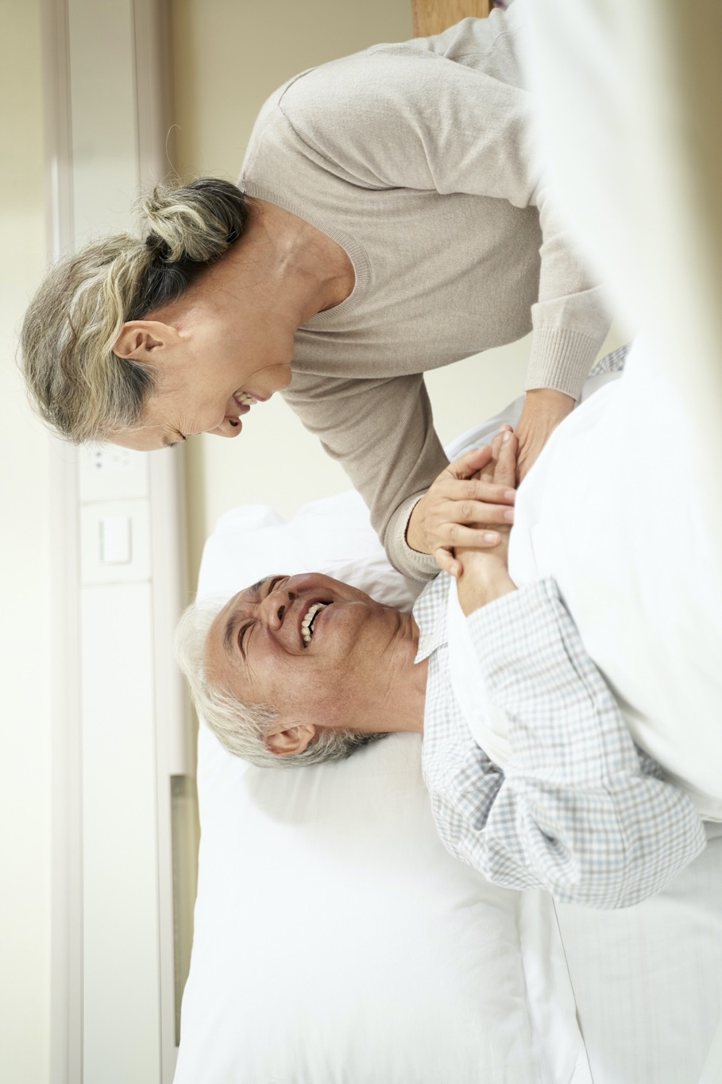
GREATER LOVE
Field Hospital

Slide 14
GREATER LOVE
Recovery
If I have all faith, so as to remove mountains, but do not have love, I am nothing. Love is patient; love is kind; love is not envious or boastful or arrogant or rude. It does not insist on its own way; it is not irritable or resentful; it does not rejoice in wrongdoing, but rejoices in the truth. It bears all things, believes all things, hopes all things, endures all things.
When I was a child, I spoke like a child, I thought like a child, I reasoned like a child; when I became an adult, I put an end to childish ways. And now faith, hope, and love abide, these three; and the greatest of these is love. 1 Cor 13:2-3,4-7,11-13
1. Touch
I touch the Heart of Increasing Love.
I hold an object that symbolises for me the feeling of increasing love for God.
I remember a small story of receiving greater love when I needed it. If praying alone I hold that memory, if I am praying in a group, I share it with them, listening in turn to their stories, feeling touched by the Spirit of Greater Love … I begin to understand how important greater love is to my recovery in these barren times.
2. Desire
I desire the gift of Greater Love.
I consider three things, taking a few minutes exploring each. I ask myself: Where is do I feel love increasing in my life? ...
Where is do I feel love increasing in my life? ... What diminishes love in me? ...
I ask the Spirit for an increasing, trusting love, to build me up in this time of recovery.
3. Choice
Today I choose the Way of Greater Love.
I slowly and prayerfully read the prayer text above. I choose, in three thoughtful steps, the direction I wish to take:
I choose the loving way, led by greater love and the good spirit toward God’s love. I reject the loveless way, cold, isolated and selfish, drawn down by the bad spirit.
I walk towards the gift and the Giver, from affection, to greater love, to peace in God.
4. Loving
I live in the Spirit of Greater Love.
I imagine that the Spirit addresses me by name, saying, ‘Love others, both friends and strangers, as I have loved you.'
So I rest now, and reflectively through the whole day, in the Spirit’s loving, healing, intimacy. I feel love grow and thrive within me ...
I conclude in thanks, considering two questions. Firstly, if possible, how might I make contact and reconnect with the one who showed me greater love. Secondly, to whom and how do I pass on this exercise. Who urgently needs greater love now?
FSE FIELD HOSPITAL © Michael Hansen SJ
Contact: field-hospital@fsecloud.life • www.fsecloud.life • JISA ministries www.jisa.org.au

